Slide 1
Marek Dabrowski Fellow at CASE, Non-Resident Fellow at Bruegel Eastern European economies amidst the global and regional shock
Presentation at the Bruegel event on ‘Economic dynamics in the former Soviet Union countries amidst global shocks’,
Brussels, 26 February 2025

Slide 2
Presentation’s background, purpose and content
A regional report of the OSF funded project on “Increasing economic resilience of Armenia, Georgia and Moldova” carried out by CASE – Center for Social and Economic Research in Warsaw, and three partner institutes (Modex, Yerevan, EPRC, Tbilisi, and Expert-Group, Chisinau);
It covers the period of 2007-2023/2024, with special focus on 2020-2023/2024 and seven countries: Armenia, Azerbaijan, Belarus, Georgia, Moldova, Russia, and Ukraine
It covers four policy areas: macroeconomic stability, financial stability , external economic relations, and energy sector, plus political and geopolitical background

Slide 3
Macroeconomic situation (a summary)
External shocks: global financial crisis (2008-2009), decline in commodity prices (2014-2016), COVID-19 (2020), global inflation (2021-2023), war in Ukraine (2022 - ?)
War in Ukraine:
Losers: Ukraine (war damages), Russia & Belarus (sanctions, capital outflow), Moldova (energy shock, conflict neighbourhood)
Armenia, and Georgia – temporary winners (trade redirection; inflow of capital, people and businesses from Russia)
Azerbaijan - neutral
Negative demographic trends deepened by large outward migration (seasonal and permanent), but a large inflows of remittances

Slide 4
Annual changes in real GDP, in %, 2007-2024
Source: IMF WEO Database, October 2024

Slide 5
Body
BRUEGEL​

Slide 6
Source: IMF WEO Database, October 2024

Slide 8
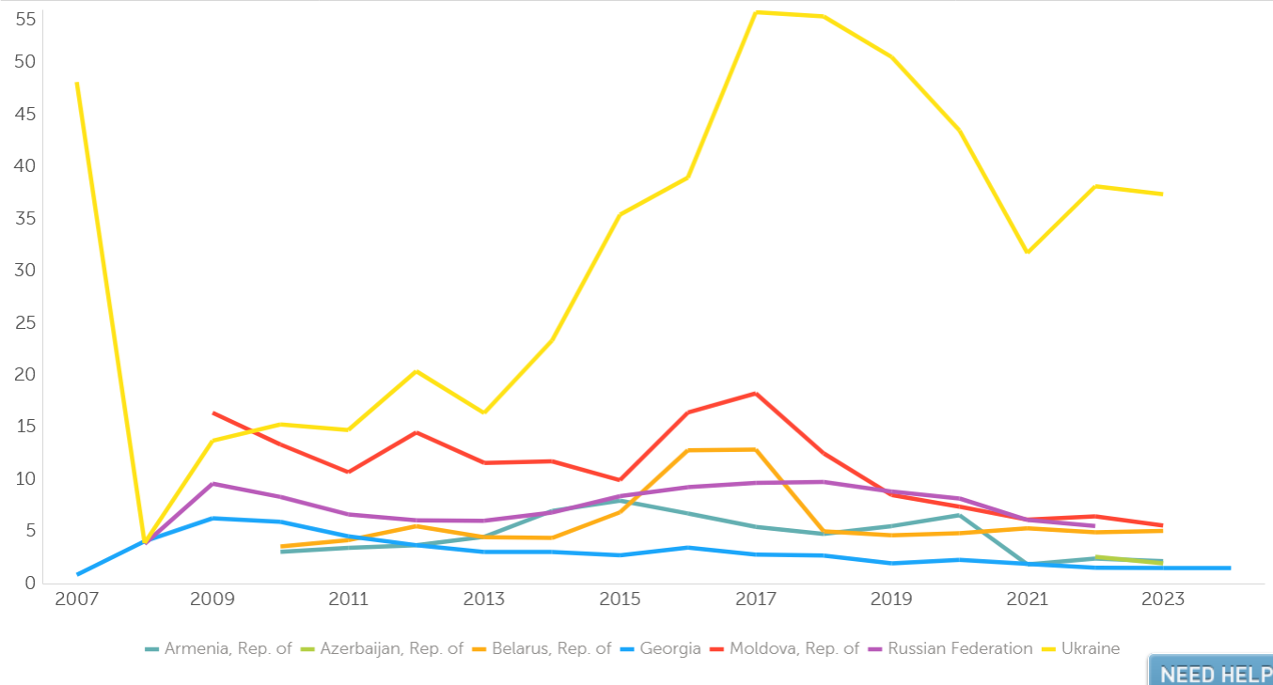

Slide 11
Stock on inward FDI, % of GDP, 2007-2023

Slide 13
Sources of vulnerabilities
Geopolitical and security risks, ongoing and unresolved frozen conflicts
Domestic political instability (actual and potential)
Deficiencies in governance and business climate
Trade shocks (global and regional)
Energy dependence on Russia and hydrocarbons
Macroeconomic and financial fragility

