Slide 1
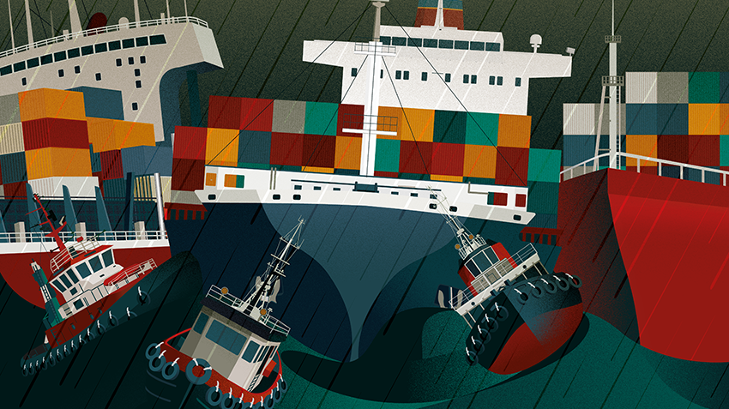
RESHORING, NEARSHORING OR FRIENDSHORING:
WHAT IS THE FUTURE OF GLOBAL SUPPLY CHAINS?

Slide 2
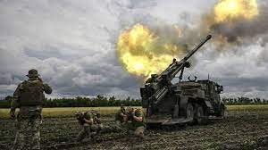
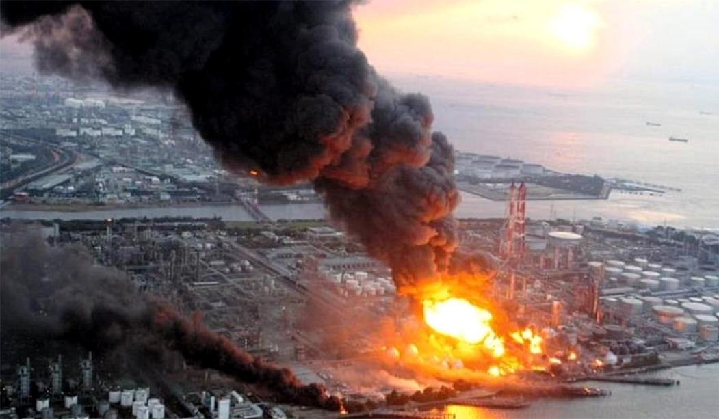
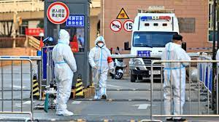
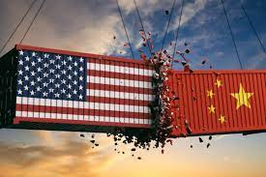
Supply chain disruptions are not going away any time soon . . .

Slide 3
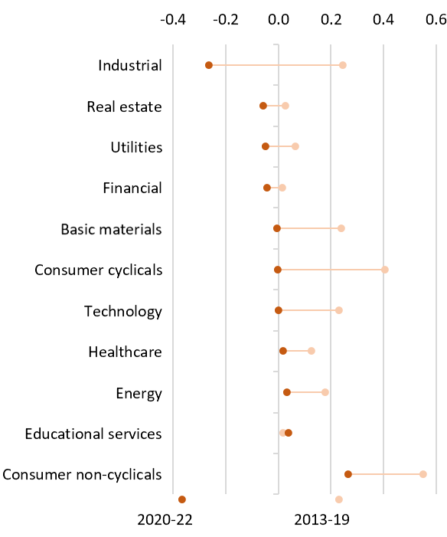
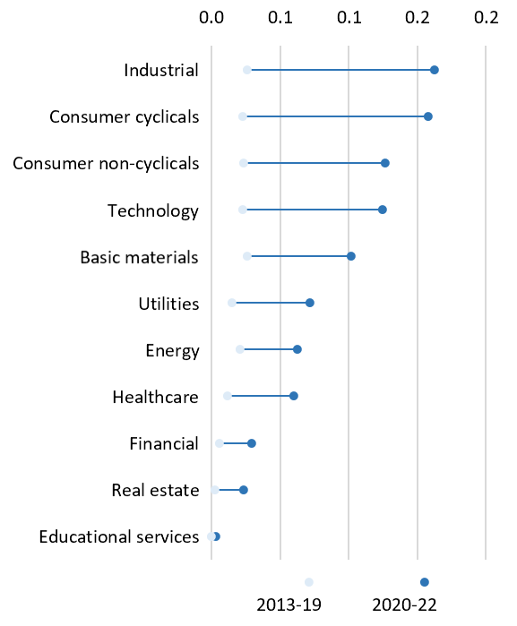
Perceived supply chain risk has increased globally,
and sentiment has deteriorated across all sectors
Panel A. Average net number of positive sentences on supply chains
Panel B. Average number of sentences on supply chains and risks
Source: NL Analytics and authors’ calculations. As of 13 Jul 22. Panel A : Number of sentences per earnings call containing a supply chain-related keyword + positive tone vs supply chain + negative tone. Panel B shows the average number of sentences per earnings call containing a supply chain-related keyword + sense of risk
3

Slide 4
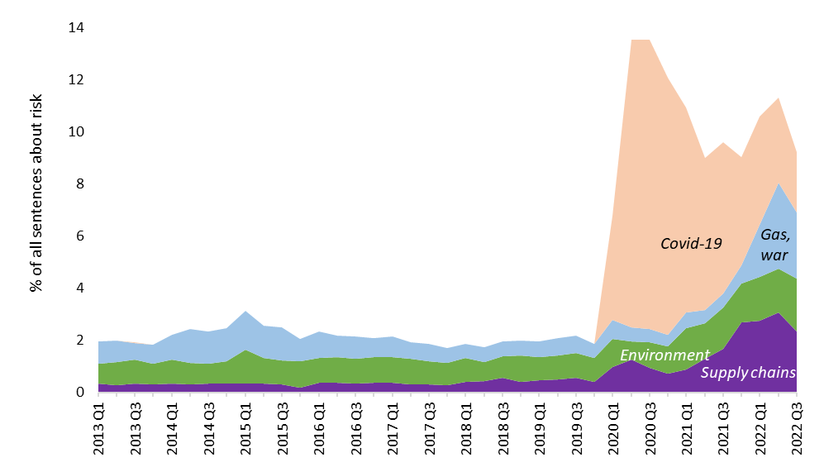
Supply chain disruptions are among top concerns for global firms and investors
Source: NL Analytics and authors’ calculations. Data as of 13 July 2022. The chart shows the share of sentences that contain at least one risk word and one topic-related keyword. Covid-19 keywords based on Hassan et al. (2020); Russia-Ukraine Hassan et al. (2021) + NL Analytics tool; climate change Sautner et al. (2021).
4

Slide 5
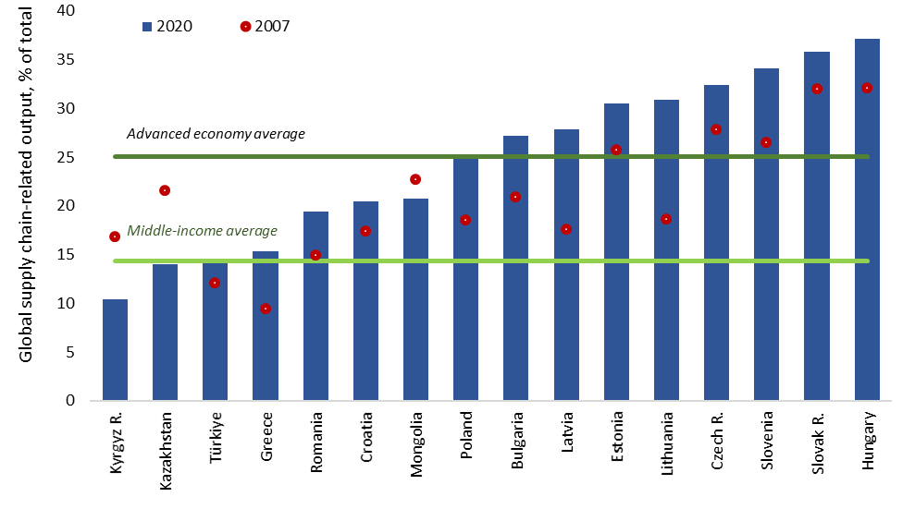
EBRD regions have been well integrated in global supply chains
Source: Eora26 (up to 2015) and Asian Development Bank’s Multi-regional Input-Output (MRIO) via World Bank’s World Integrated Trade Solution (WITS) website and authors’ calculations. 2020, 2015 if 2020 not available. All sectors.
5

Slide 6
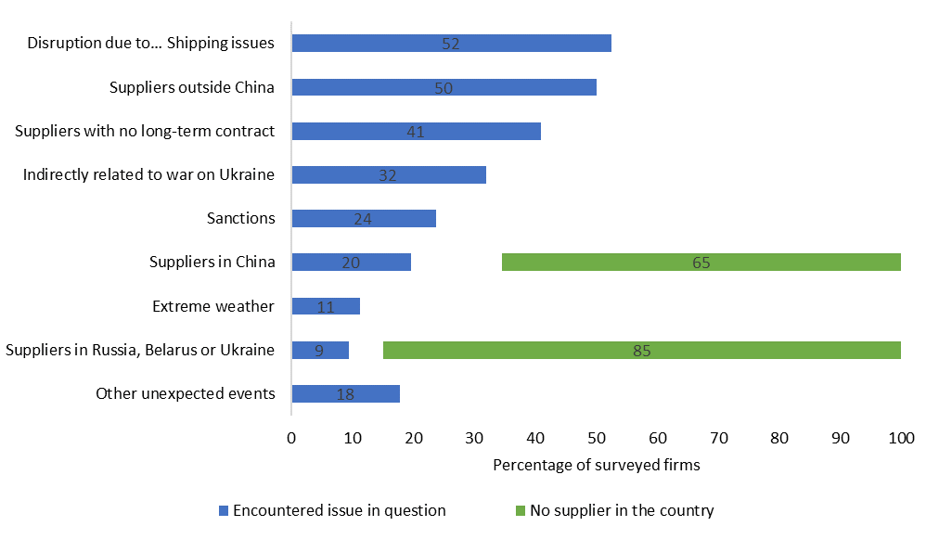
More than half of firms in the Emerging Europe faced supply chain disruptions
Source: EBRD survey and authors’ calculations. 815 firms that export and import in 15 economies.
6

Slide 7
The war has triggered reshaping of global supply chains
Source: EBRD survey and authors’ calculations. 815 firms that export and import in 15 economies.
7

Slide 8
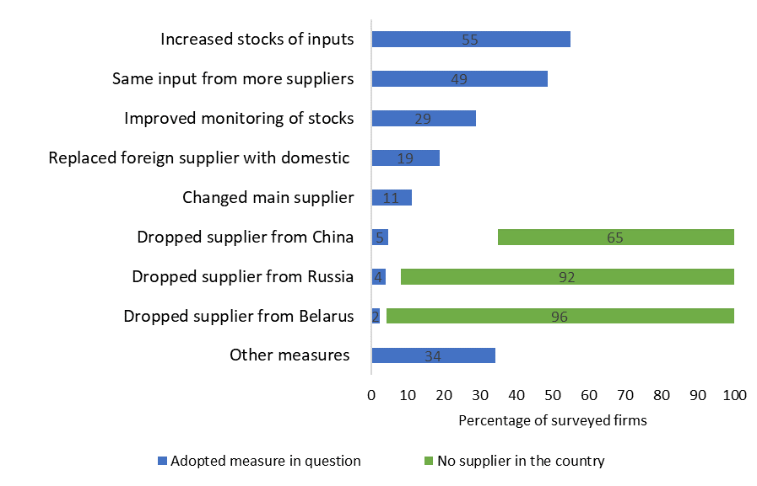
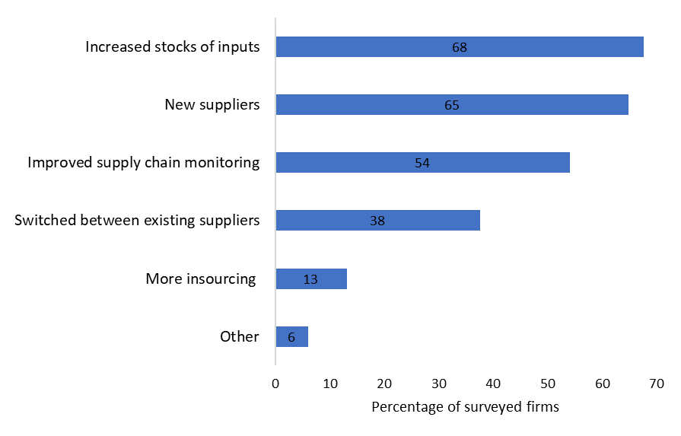
Reshaping of global supply chains has already started
Share of firms reporting undertaking measures to increase supply chain resilience
EBRD regions
Germany
Source: EBRD survey, Ifo Business Survey (July 2022) and authors’ calculations. Based on responses of 815 firms that both export and import across 15 economies in the EBRD regions and a survey of more than 3,000 manufacturing firms in Germany.
8

Slide 9
Not much evidence of reshoring
Share of firms reporting undertaking measures to increase supply chain resilience
EBRD regions
Germany
Source: EBRD survey, Ifo Business Survey (July 2022) and authors’ calculations. Based on responses of 815 firms that both export and import across 15 economies in the EBRD regions and a survey of more than 3,000 manufacturing firms in Germany.
9

Slide 10
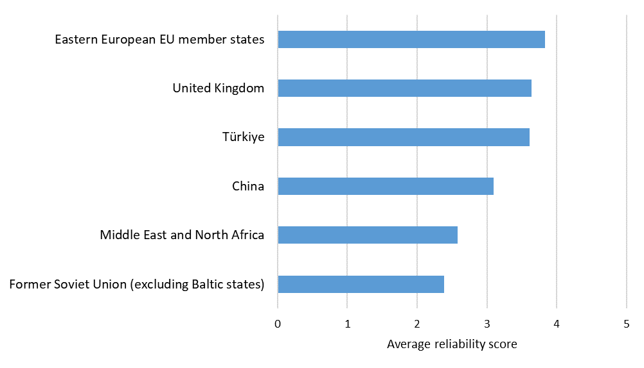
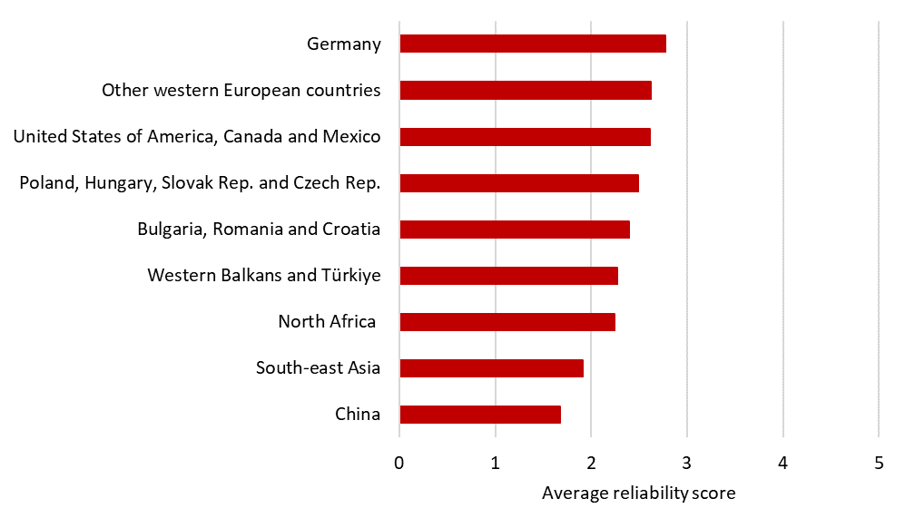
Emerging Europe, Turkiye and North Africa stand to benefit
Reliability of suppliers
(as perceived by firms in the EBRD regions)
Reliability of suppliers
(as perceived by German firms)
Source: EBRD GSC Disruptions Enterprise Survey Follow-up, Ifo Business Survey (July 2022) and authors’ calculations. Average perceived reliability on a scale from 1 (very unreliable) to 5 (very reliable).
10

Slide 11
RUSSIA’S WAR
ON UKRAINE
HAS RESHAPED TRADE FLOWS

Slide 12
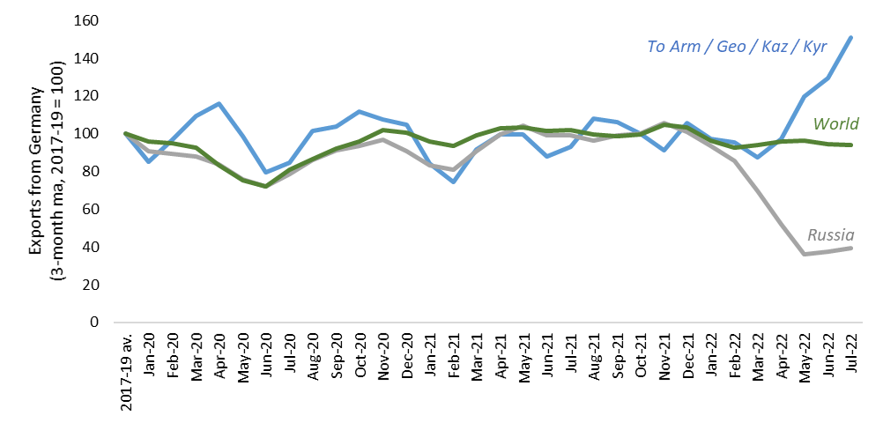
German exports to Russia dropped by more than a half
Source: Comtrade and authors' calculations. As reported by exporters (eg Germany). Trade in nominal US dollars is adjusted for US inflation. Monthly average taken across all months in 2017-19.
12

Slide 13
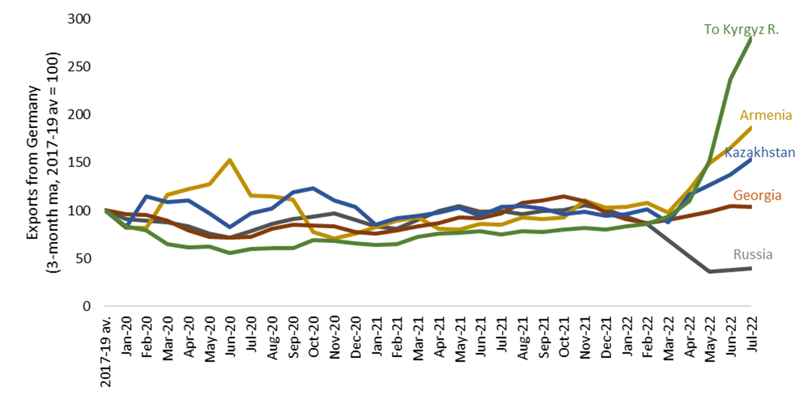
While German exports to Central Asia and Caucasus went up
Source: Comtrade and authors' calculations. As reported by exporters (eg Germany’s reported exports to Russia). Trade in nominal US dollars is adjusted for US inflation. Monthly average taken across all months in 2017-19.
13

Slide 14
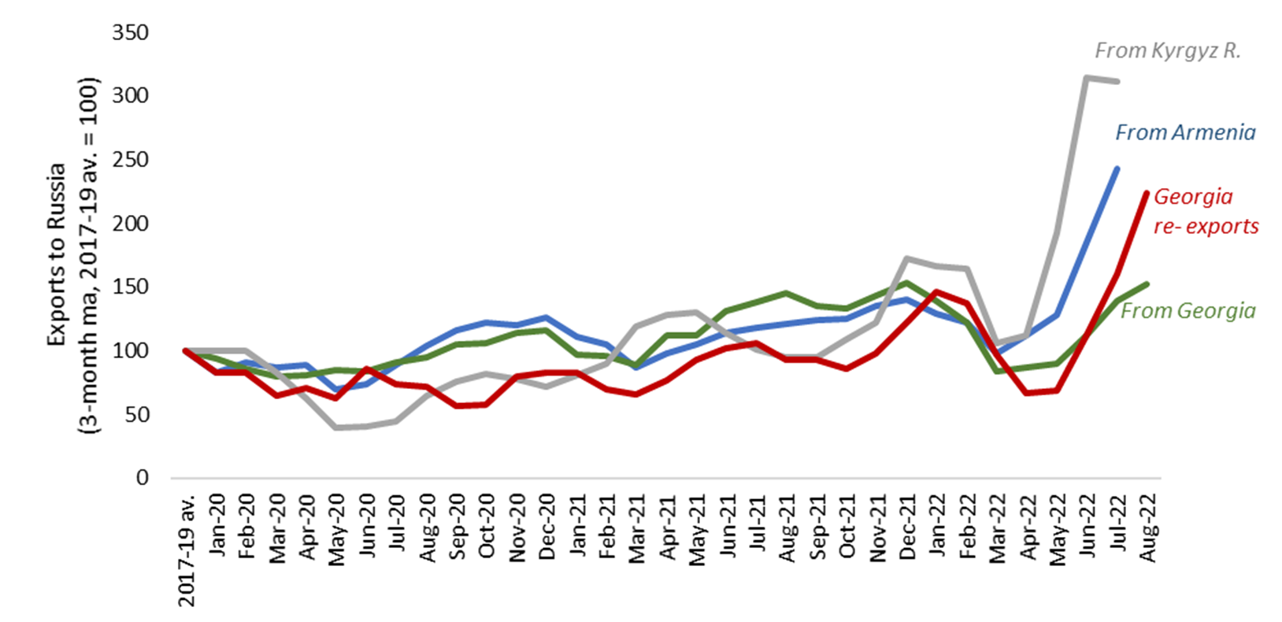
Kyrgyz Republic, Armenia and Georgia have increased exports to Russia
Source: Comtrade and authors' own calculations. As reported by exporters (for instance, Georgia’s reported exports to Russia). Trade in nominal US dollars is adjusted for US inflation. Monthly average taken across all months in 2017-19.
14

Slide 15
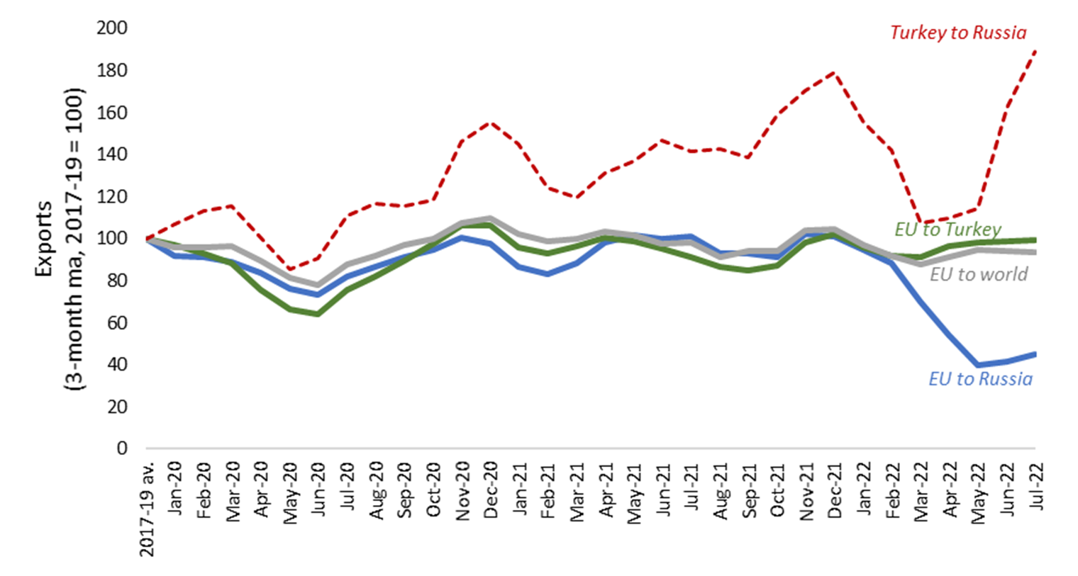
Turkey’s exports to Belarus & Russia also increased but they appear to originate in Turkey as EU’s exports to Turkey only marginally higher
Source: UN Comtrade and authors’ calculations. As reported by exporters (for instance, Turkey’s exports to Russia, Germany’s exports to Turkey). Trade in nominal US dollars is adjusted for US inflation. Monthly average taken across all months in 2017-19.
15

Slide 16
MORE
TURBULENCE AHEAD

Slide 17
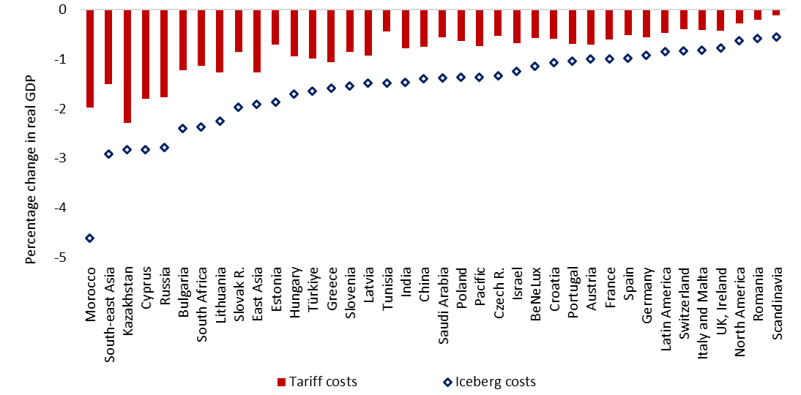
Friendshoring can provide some insurance against supply disruptions –
at an overall welfare cost
Modelled real GDP changes in response to a 20% pt increase in trade costs between economies that condemned the invasion of Ukraine vs other
Source: OECD ICIO Tables, WITS, and authors’ calculations. Based on a model. Tariff revenues accrue to governments; iceberg costs do not accrue to governments. Economies that condemned the invasion of Ukraine are those that voted in favour of the UN resolution on 2 March 2022.
17

Slide 18
European Bank for Reconstruction and Development
Five Bank Street London E14 4BG United Kingdom
www.ebrd.com
Discover more at tr-ebrd.com
Find us on:
@EBRD ebrdhq EBRD ebrd_official ebrdtv

